Slide 1
ASSESSMENT AND ARTIFICIAL INTELLIGENCE: PART 2
ZACH JUSTUS

Slide 2
AI HAS CHANGED THE WORLD NOT JUST YOUR CLASS
"AI's going to make it virtually impossible for a one-off moment of learning [like a degree] to last an entire career” LinkedIn CEO Ryan Roslansky (2023)
“Seventy-five percent of knowledge workers now use AI at work”
“78% of AI users are bringing their own tools to work” (Microsoft/LinkedIn Work Trend Index, 2024)

Slide 3
REVIEW/PREVIEW
Morning Session
Reflect on why we assess
Identify how AI has disrupted assessment
Locate the stakeholders in change
Afternoon Session
You have a pause. Now what?
Rethinking Student Learning Outcomes
The new/old players in assessment
Mapping a course forward

Slide 4

DURING THE PAUSE: TALK TO EMPLOYERS AND GRADS
How has AI changed what hiring managers are looking for?
How has AI changed how new employees work?
How are employers evaluating readiness?
What retraining is necessary and is there a new role for your institution?
You can also ask these questions of a LLM like ChatGPT

Slide 5
DURING THE PAUSE: TALK TO OTHER STAKEHOLDERS
Civic Organizations
  How are they dealing with voter information?
  How do they perceive AI literacy?
  What do they think the next 18 months will look like?
Share and Organize with Peers
  What are the implications for your curriculum?
Other Professors
  The classes in sequence need to coordinate with each other
  How can we align on guidelines rather than fight each other?
Consider Accredidation Bodies
  Are there guidelines for University or Program specific accredidation?

Slide 6
BUILDING SHARED FRAMEWORKS WITHIN PROGRAMS
Ideally this project is shared and the learning is pooled
AI “policy” does not make sense
Frameworks for dialogue reflect a changing world
Programs of study should aspire to shared frameworks
This will allow comparison across courses—now we are ready to assess

Slide 7
APPLICATION TIME!
Let’s assume a middle ground where your program (support or academic) creates a framework where students are using AI to help them complete tasks like writing and problem solving. We are pooling material from different sections to assess.
Is what we are looking for different, perhaps better than it was before?
Are we relying on the tests and standards from hiring managers (write copy, solve this problem, code this task, etc.)?
What is absolutely out that we used to do?
Imagine you need to explain this to an someone who works in accreditation, what do you say?

Slide 8

MOVING FORWARD
Degree programs and ongoing education—once in a generation opportunity for higher education
This landscape will change again, this is not a one-off project so we need to build revision into our workflow

Slide 9
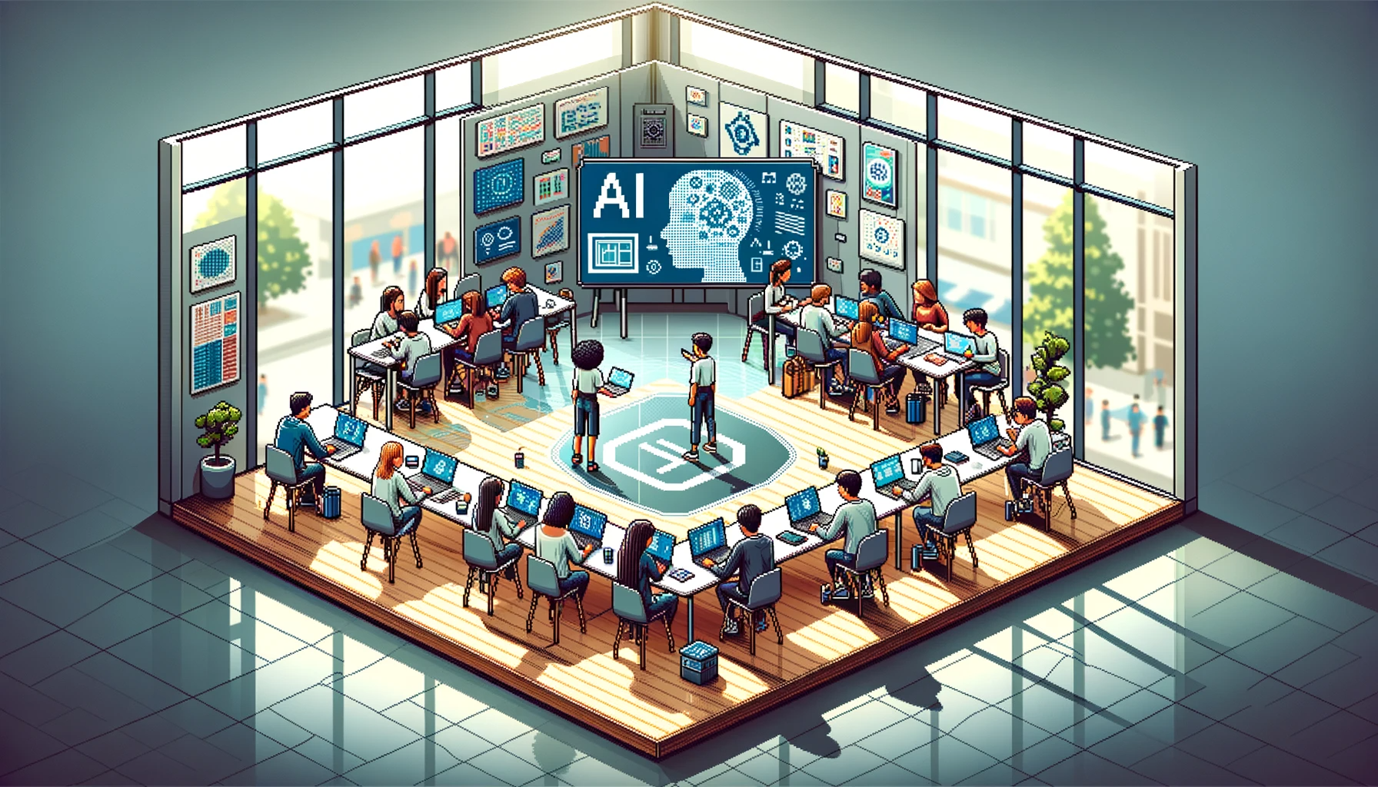
QUESTIONS AND CLOSE

