Slide 1
ASSESSMENT AND ARTIFICIAL INTELLIGENCE: PART 1
ZACH JUSTUS

Slide 2
AI HAS CHANGED THE WORLD NOT JUST YOUR CLASS
"AI's going to make it virtually impossible for a one-off moment of learning [like a degree] to last an entire career” LinkedIn CEO Ryan Roslansky (2023)
“Seventy-five percent of knowledge workers now use AI at work”
“78% of AI users are bringing their own tools to work” (Microsoft/LinkedIn Work Trend Index, 2024)

Slide 3
PREVIEW
Morning Session
Reflect on why we assess
Identify how AI has disrupted assessment
Identify the stakeholders in change
Afternoon Session
You have a pause. Now what?
Rethinking Student Learning Outcomes
The new/old players in assessment
Mapping a course forward

Slide 4
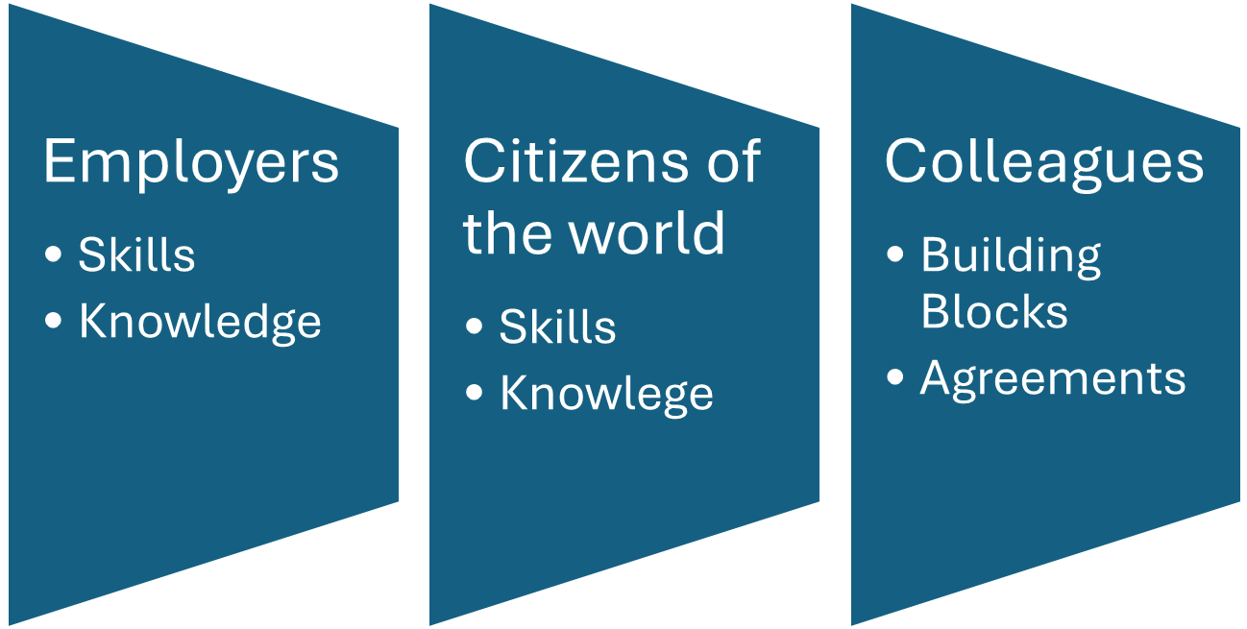
WHAT DO STUDENTS NEED TO KNOW?

Slide 5
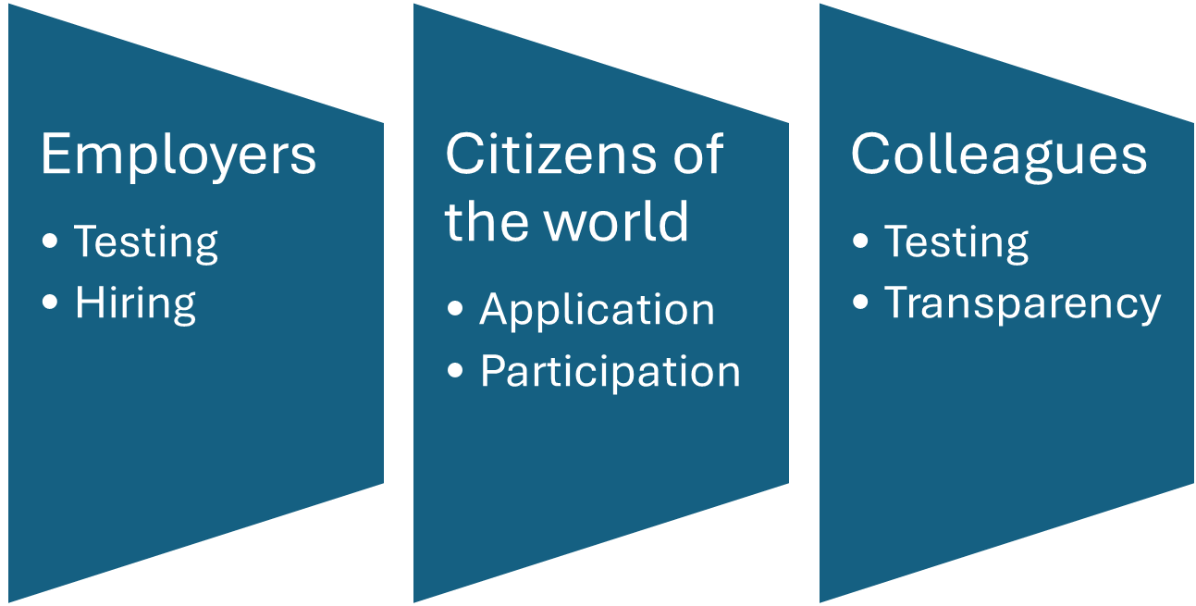
HOW DO WE KNOW IF THEY HAVE LEARNED?

Slide 6

THE PROBLEM
If we cannot tell what students have produced compared to what AI has produced or co-authored we are no longer, as of right now, assessing student learning.

Slide 7
ASSESSMENT TIMELINE FOR STUDENT LEARNING OUTCOMES
Before 11/22
11/22-Present
Future
Students complete tasks to show achievement of outcomes
We analyze the evidence of tasks (exams, essays, etc.)
Students complete tasks with and without AI
We analyze the evidence of tasks–even though things are quite different
Current plan: Pretend like everything is fine and just keep doing the same thing
Students expand the use of AI for even more tasks
Option 1: Give up on assessment
Option 2: One year pause on assessment to allow programs to reevaluate processes and understand outcomes

Slide 8

WHO WRITES AI GUIDELINES?
University policy making
Department/program norms
Individual course guidelines (primary area)
Reflection Activity: Turn to Your Peers
Where did your policy come from?
Has it changed over time?
Is it shared?
Is you class in a sequence where decisions in one class impact preparedness for the next?

Slide 9

WHAT HAPPENS TO THE DATA FROM INDIVIDUAL CLASSES?
Local assessment: This is the focal point of program assessment
Campus assessment: Lumped together with other classes with different policies to assess university writing
Success rates and equity gaps: Class compared and categorized
Aggregated together with classes for University accreditation

Slide 10
IMPLICATIONS
Instructors: re-evaluate or re-write student learning outcomes (SLOs)
University curriculum boards & committees and Dean’s offices: re-write writing proficiency guidelines and SLOs
Assessment reports: rethink trends in student assessment from pre fall 2022 and after
Accrediting body: now is the time to show leadership and bridge the gap between education and stakeholders

Slide 11

REFLECTION ACTIVITY: TURN TO YOUR PEERS
Explain your current role in the assessment of student learning
What are the challenges of creating common AI guidelines?
  Stakeholder Priorities
  Bureaucracy
  Academic Freedom
Was assessment working well before this all started?
You have a magic wand for assessment, what do you do with it?

Slide 12
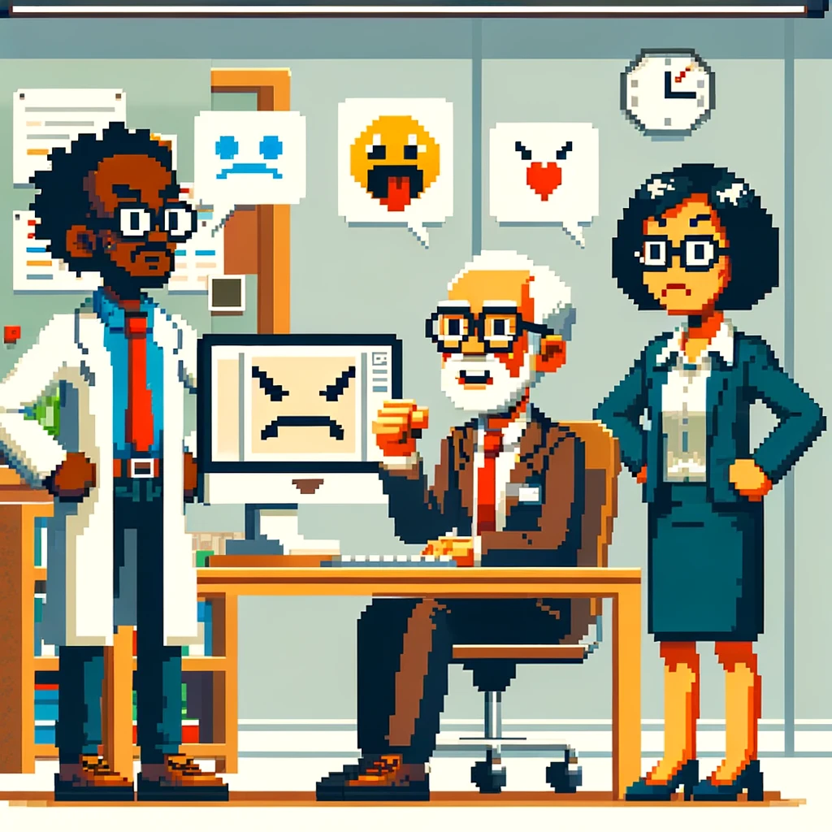
PLAN FOR AFTER LUNCH
You have a pause. Now what?
Rethinking Student Learning Outcomes
The new/old players in assessment
Mapping a course forward

