Slide 1
Love at First Insight: Embracing Student Feedback
Yasmene Kimble - yasmene.kimble@stonybrook.edu
Rose Tirotta-Esposito - rose.tirotta-esposito@stonybrook.edu
Center for Excellence in Learning and Teaching (CELT)

Slide 2
Session Objectives
Understanding the Value of Student Feedback
Identify Trends and Patterns
Reflect on Potential Instructional Improvements

Slide 3
Agenda
Introduction
Understanding Course Evaluation Data
Reviewing Your Course Evaluations
Discussion and Suggestions

Slide 4
What was the completion rate of course evaluations for your Fall 2024 courses?

Slide 5
Importance of Student Feedback
Enhances Teaching Quality: Informs educators of students’ perspective on their academic experiences
Promotes Student Engagement: Fosters a sense of involvement and investment
Identifies Strengths and Weaknesses: Recognizes areas of success and areas needing attention
Supports Continuous Improvement: Encourages ongoing assessment of teaching and course content
Facilitates Communication: Opens dialogue between students and instructors, leading to a more responsive educational environment
Resource: Indiana University Bloomington and Vanderbilt University

Slide 6
Understanding Course Evaluation Data
Types of Data Collected
  Quantitative Data: Likert Scale Responses: Numerical ratings (e.g., 1-5) on various aspects of the course
  Qualitative Data: Open-Ended Responses: Written comments
Common Trends and Patterns
  High Ratings: Consistently high scores in certain categories indicate strengths
  Low Ratings: Areas with lower scores highlight potential issues
  Consistent Themes: Repeated comments or concerns across multiple evaluations
  Outliers: Unique or extreme responses that may require special attention
Source: Boise State University

Slide 7
Interpreting and Decoding Student Comments
Identify Key Words and Phrases: Look for recurring themes or words in comments
Contextual Understanding: Consider the context of feedback
  (e.g., student workload, course difficulty)
Actionable Insights: Focus on comments that provide specific suggestions or highlight clear areas for improvement
Source: Boise State University

Slide 8
Qualitative vs Quantitative Feedback
Stony Brook Course Evaluation Questions
Quantitative
4. The grading was based on the requirements stated in the syllabus.
Agree
Grading did not match the syllabus
There was no syllabus
I did not read the syllabus
I don’t know
5. The textbook, readings and required resources were valuable.
Agree
Disagree
I did not read the required materials
No text, readings or resources were required
Qualitative Data
11. What, if anything did you find valuable about this course?
12. In what ways, if any, could this course be improved?

Slide 9
Using AI as a Thought Partner and Peer Mentor
How AI can help
  Summarize key trends and themes
  Offer recommendations based on the feedback received
  Provide practice suggestions to improve teaching methods and course design
Example Prompts
  From the responses to question 12, can you identify one strength and one area of improvement?
  How can I address the most common concerns shared by students?
  What strategies can I implement to improve student engagement based on feedback?

Slide 10
Helpful Resources

Slide 11
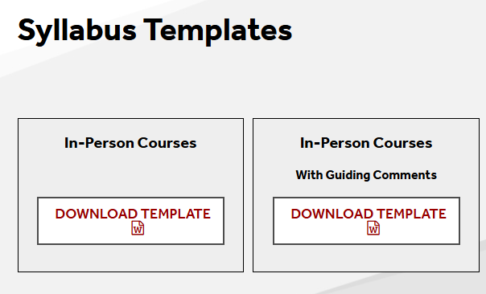
CELT Syllabus Template
Visit the CELT website for syllabus resources
  Syllabus review
  Syllabus templates
  Generative AI Syllabi statements and more!

Slide 12
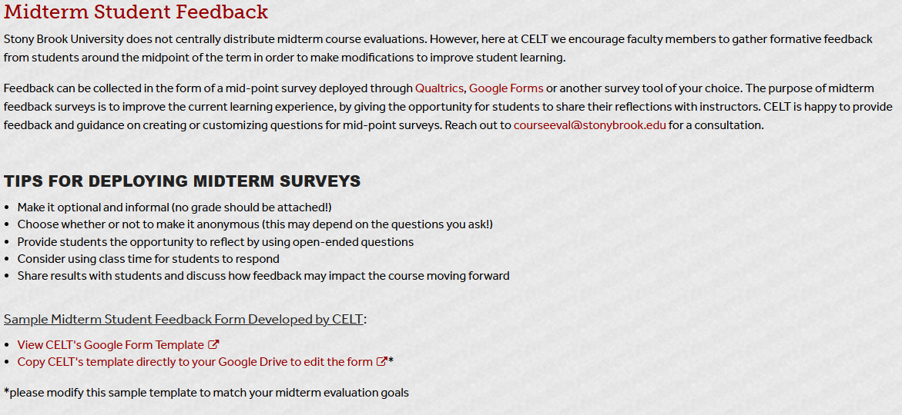
Mid-Semester Evaluation
Consider administering mid-semester course evaluations
  Visit the CELT website for more information

Slide 13
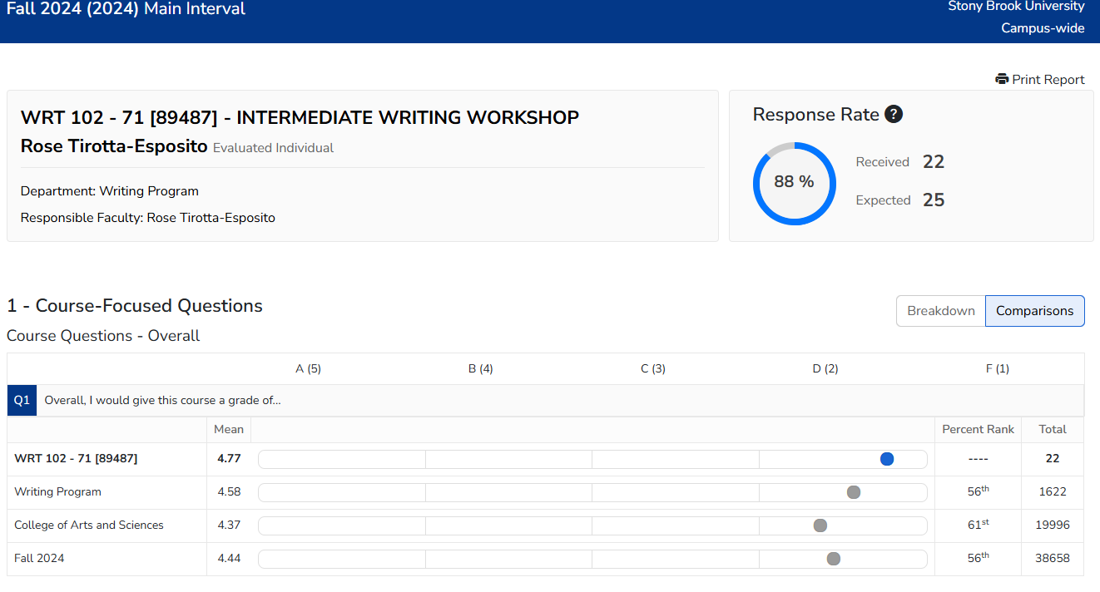
Course Eval Comparison Report

Slide 14
FYI
New Course Evaluations - Spring 2025
  New course evaluation questions will be launched this semester

Slide 15
Current Questions (used since 2014)
The instructor was effective in teaching the subject matter [5pt Likert]
Instructor expectation of students is reasonable. [5pt Likert]
What is the most effective way to contact the instructor outside of class? [Options].
What is your reason for taking this course? [Options].
Overall, I would give this course a grade of...[A-F, 5-point scale]
The grading was based on the requirements stated in the syllabus. [Options].
On average, how many hours per week did you spend on this course outside of class? [Options]
The textbook, readings and required resources were valuable. [Options].
Did the use of the required textbooks, readings or resources sufficiently justify their cost? [Options].
My anticipated grade in this class is: [Scale: A,B,C,D,F,P,S,U, I Don’t Know]
How often did you attend this class? [Options].
What, if anything, did you find most valuable about this course? (Open)
In what ways, if any, could the course be improved? (Open)

Slide 16
Revised Questions (will launch sp25)
The instructor clearly communicated what was expected of me in this course and the rules of classroom engagement. [5pt: Strongly Agree to Strongly Disagree]
The instructor was effective in teaching the subject matter [5pt: Strongly Agree to Strongly Disagree]
I think the overall quality of the course was [Excellent, Very Good, Good, Fair, Poor]
The course content (assignments, readings, lectures, etc.) helped me meet the learning expectations set forth by the instructor. [5pt: Strongly Agree to Strongly Disagree]
The textbook, readings and required resources were valuable. [Agree / Disagree / I did not read the required materials / No text, readings or resources were required]
The class environment was inclusive towards people of diverse backgrounds, identities, life experiences and diversity of thought. [5pt: Strongly Agree to Strongly Disagree]
The methods of evaluating my work were fair. [5pt: Strongly Agree to Strongly Disagree]
On average, how many hours did you spend on the course outside of class? [0-3 hours / 4-6 hours / 7-9 hours / 10+ hours]
What did you find most valuable about this course? (open)
In what ways could the course be improved? (open)

Slide 17
Reviewing Your Course Evaluation
Log onto Course Eval
Select one course from Fall 2024
  Choose one course you taught last semester for review
Review student feedback
Questions to focus on
  Question 4: The grading was based on the requirements stated in the syllabus.
  Question 5: The textbook, readings and required resources were valuable.
  Question 11: What, if anything did you find valuable about this course?
  Question 12: In what ways, if any, could this course be improved?
Note Feedback Trends
  Identify and document common themes, patterns, and trends in the feedback

Slide 18
Reflection and Discussion
Insights and Trends
Were there any surprising patterns or insights that stood out to you?
Concerns and Positive Feedback
What were the most frequently mentioned concerns from students?
What positive feedback did you receive that you can build upon?
Actionable Improvements
Based on the feedback, what specific changes can you implement to address student outcomes?
How can you enhance the aspects of the course that received positive feedback?

Slide 19
Questions?

