Slide 1


DARE TO BE
Swipe Right on Surveys: Designing Questions Everyone Will Love
Simran Kaur
Ahmed Belazi
CRAFT Team | Division of Student Affairs

Slide 2


Survey Process
Target
Who is your target population and how could this help us understand them?
How will it contribute to our current understanding?
What will you do with your data?
Goals
What actionable steps can be taken with the data collected?

Slide 3
What are (some) things that make a good question?
Make it count
One thing at a time
Don’t lead
Avoid jargon
Avoid fatigue
Test it out!

Slide 4
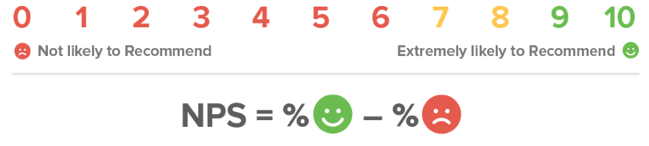
Net Promoter Scoring
Detractors -- They are not particularly thrilled by you. They, with all likelihood, won’t choose to engage with you again, and could potentially damage your reputation through negative word of mouth.
Passives -- They are somewhat satisfied but could easily switch to a competitor’s offering if given the opportunity. They probably wouldn’t spread any negative word-of-mouth, but are not enthusiastic enough to actually promote you.
Promoters -- They love you. They are your repeat customers. They are enthusiastically evangelical about you and recommend you to others.
4

Slide 5
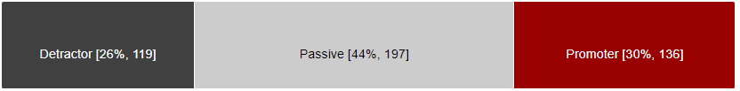
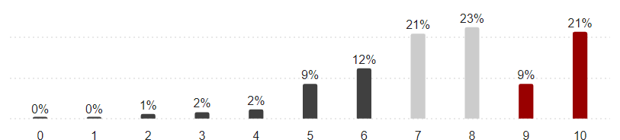
Based on your experiences during New Seawolf Welcome Week, how likely are you to recommend Stony Brook University to a friend or peer?

Slide 6
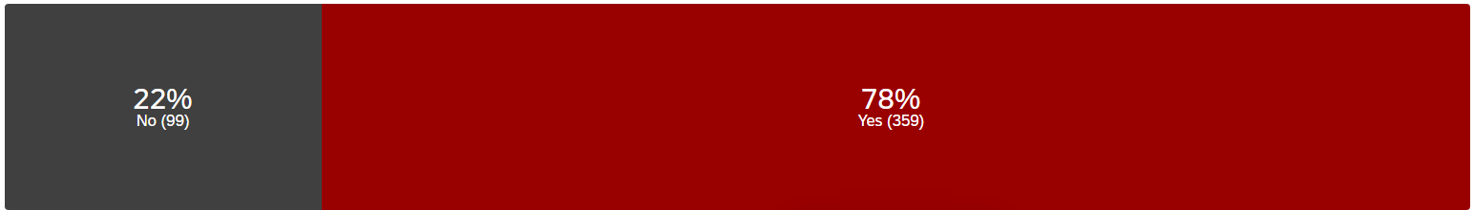
Were the experiences you had during New Seawolf Welcome Week helpful for your first week?

Slide 7
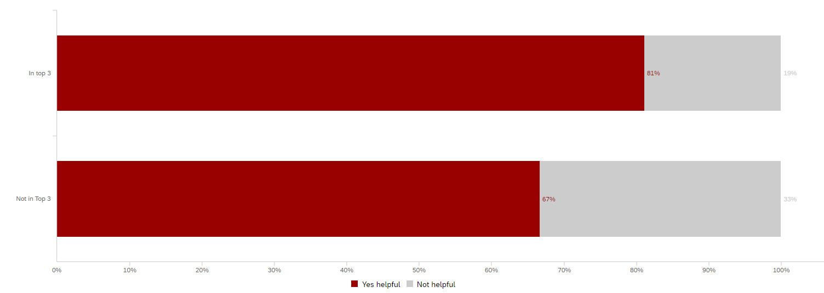
“Were the experiences you had during New Seawolf Welcome Week helpful for your first week” X “Top 3”

Slide 8
Why gather data at all?
You can't aim without measurable targets
You won't improve if you don't keep score
Telling a story is critical to our future

Slide 9
Process
Establish the goals of the project
What you want to learn
How you want to report
Determine your sample
Whom you will include in the process
Choose your data collection methodology
How you will learn
  Pre-test (if practical)
Create your questionnaire

Slide 10
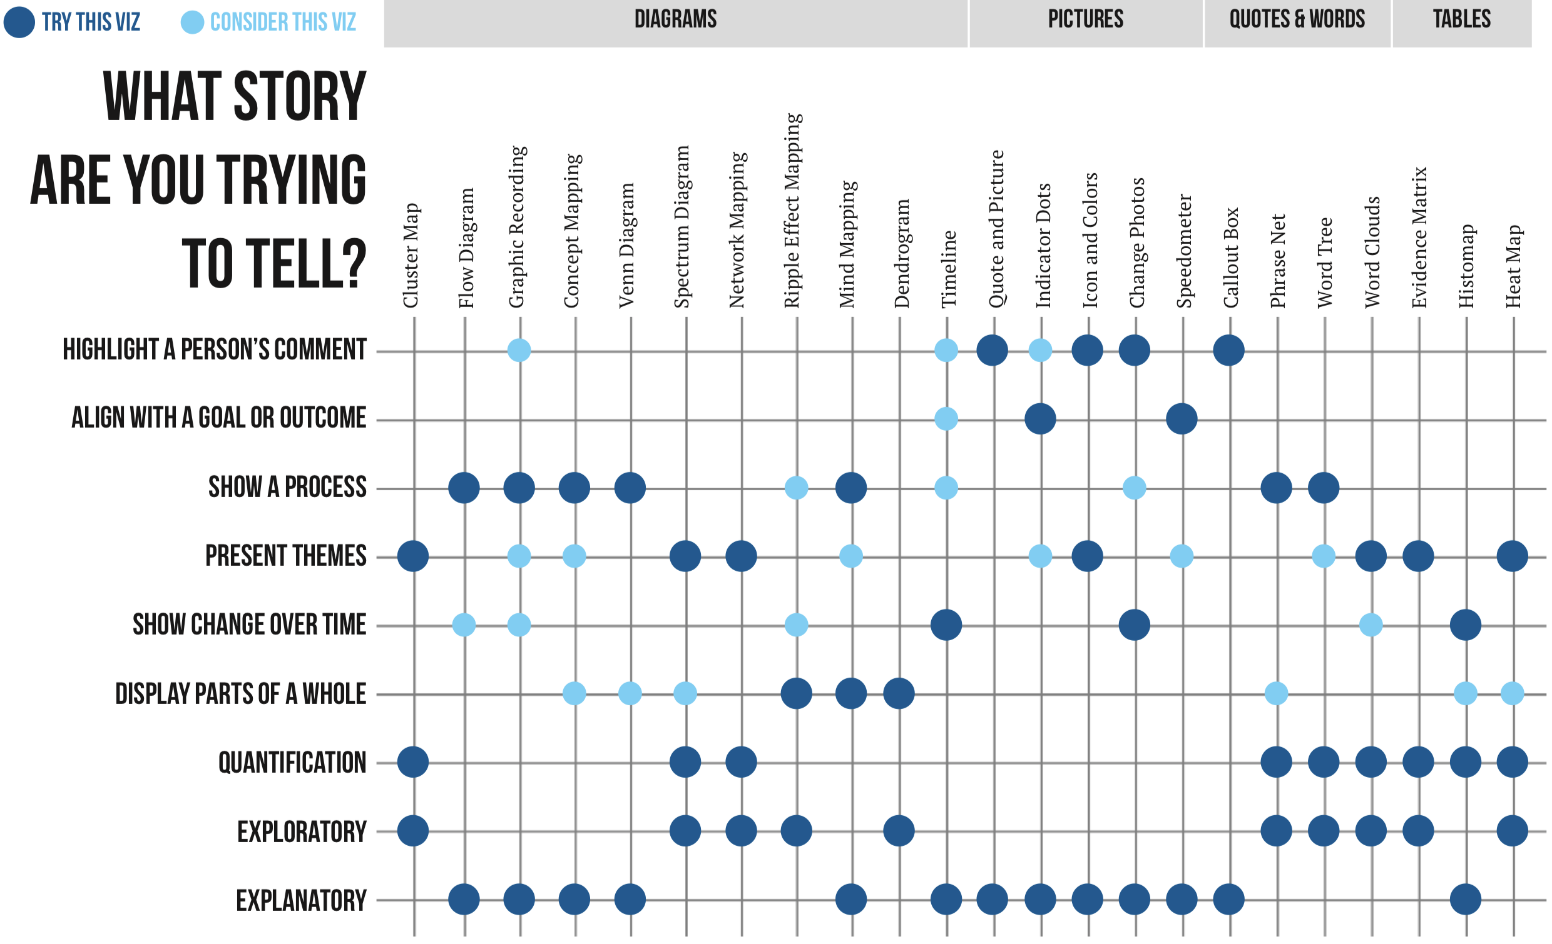

Slide 11
Process
Establish the goals of the project
What you want to learn
How you want to report
Determine your sample
Whom you will include in the process
Choose your data collection methodology
How you will learn
  Pre-test (if practical)
Create your questionnaire

Slide 12
Things to keep in mind…
Demographic questions should (if possible) be saved for the end of the questionnaire:
Age, education, income, marital status, etc.
Ensures that respondents will not feel that they are losing their anonymity when answering the rest of the questions
Choose the most important questions for your survey to be asked at the beginning of the survey

Slide 13
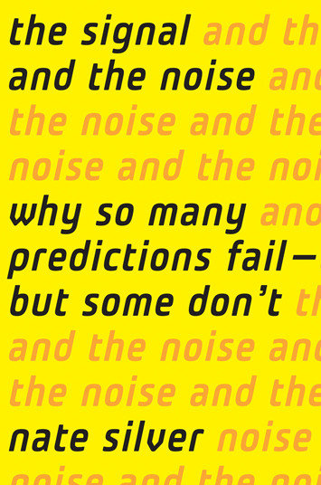


Slide 14
Follow “KISS”
  Keep it short and simple
Categorize questions into 3 groups:
  Must Know
  Useful to Know
  Nice to Know

Slide 15
Best Practices
Group related questions together
Choose first question carefully.
The first question should apply to everyone / be easy to read / be interesting
Place sensitive questions near the end giving respondents a chance to become comfortable
Ask about sequential events in the order that they occurred – think about time travel movies

Slide 16
Open-Ended
Provide respondents the opportunity to express themselves in their own words.
No correct answers to open-ended questions
Often elicit unanticipated responses which provide new directions for research
Can be difficult to interpret/analyze if clear themes do not emerge
Almost exclusively short answer format
Most cognitively taxing for respondents

Slide 17
Close-Ended
More difficult to write than open-ended questions
Have a finite set of answers
Responses are easy to standardize and analyze statistically
May miss pertinent information if a key answer is not provided to respondents (can be corrected by using “other” response option)

Slide 18

Ask one question at a time (double-barreled question)
A double-barreled question
A revision to ask each question separately and collect more info
Do you personally subscribe to, or regularly read, any periodicals, magazines, newsletters, etc. that are specifically related to your occupation?
Please indicate whether or not you personally subscribe to each of the following sources of information specifically related to your occupation.
I do subscribe
I do not subscribe
Yes
Periodicals
Magazines
Newsletters
No

Slide 19
Make every question easy to answer
A question that does not require an answer form every respondent
A revision that uses a filter question
If you made dinner at home last night, about how many minutes did it take to prepare the meal?
Did you make dinner at home last night?
Yes
No
minutes
If yes, how many minutes did it take to prepare the meal?
minutes

Slide 20

Notes:
https://stonybrookuniversity.co1.qualtrics.com/survey-builder/SV_b11u3dIKESo1SMC/edit

Slide 21
Demographic Questions
How do you describe yourself?
Select all that apply.
Male
Female
Non-binary
Prefer to self-describe (with text box)
Prefer not to say

Slide 22
Demographic Questions
What is your race or ethnicity?
Select all that apply.
American Indian/Native American or Alaska Native
Asian
Black or African American
Hispanic or Latino
Middle Eastern or North African
Native Hawaiian or Other Pacific Islander
White or Caucasian
Other (please specify)
Prefer not to say

Slide 23
NPS Question
How likely are you to recommend Stony Brook University to a friend or peer?
Not at all likely Extremely likely
1 2 3 4 5 6 7 8 9 10

Slide 24
Other Resources
Survey Management Guide
Question Type Flow Chart
Qualtrics: Writing Good Questions
Stephanie Evergreen: Data Visualization Checklist

Slide 25
