Slide 1
Chemistry URM Women Professional Mentorship Program:
Introduction and Workshop #1
Hosted by
The Bridging Science and Diversity Committee

Slide 2
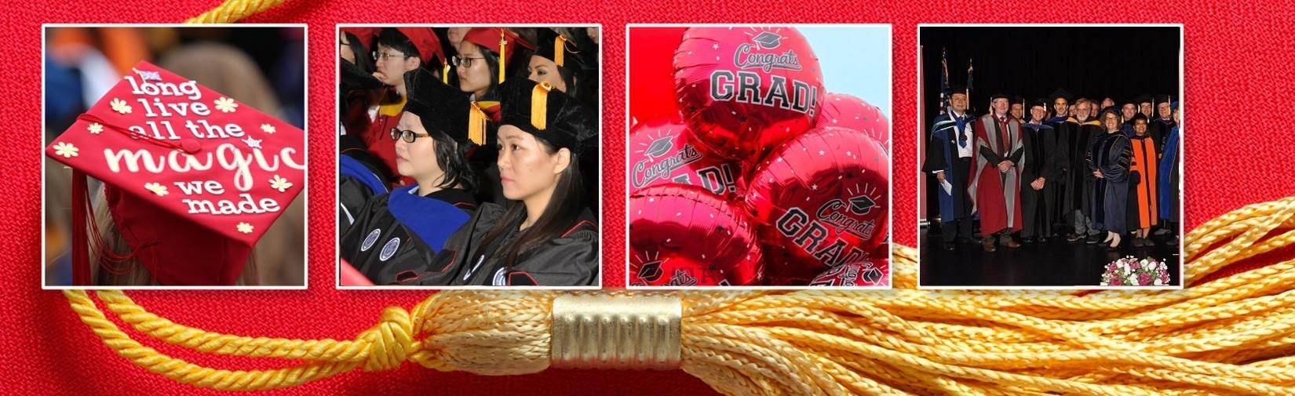
A brief history of the origins of the program
According to the National Science Foundation, underrepresented minority women (URMW) accounted for approximately…
10% of bachelor’s degrees in STEM fields → 8% of doctoral degrees in STEM → 2% of STEM faculty and 3% of employed scientists and engineers
A large discrepancy exists between the number of URMW who graduate with STEM degrees and who continue in the STEM workforce afterward.

Slide 3
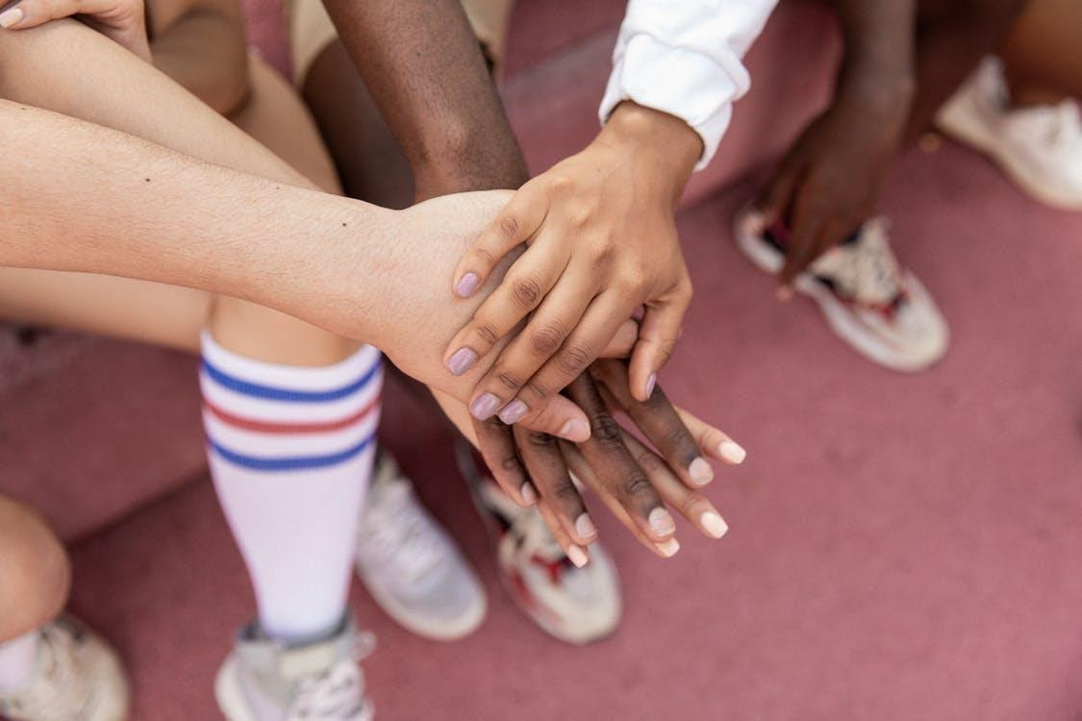
The goals of this mentoring program are…
To increase the retention of underrepresented minority women in STEM fields after graduation
To create a sense of belonging and community that can help support our members through the challenges of graduate school
Through professional development workshops and mentoring, we hope to…
  Promote conversations about career paths after graduation
  Familiarize participants with the various STEM career paths
  Prepare participants to successfully enter the job market

Slide 4

Structure and format of the program
7 professional development, networking, and team building activities will be held over the course of one year.
1st and 2nd year graduate students will be paired with a senior graduate student mentor, with whom they will be required to meet for 2 hours a month.
Senior graduate students will be paired with a faculty or alumni mentor, with whom they will be required to meet for 1 hour a month.

Slide 5
Mentor/Mentee pairings
Faculty mentor
Faculty mentor
Junior grad student
Senior grad student
Senior grad student
Alumni mentor
Senior grad student
Alumni mentor
Faculty mentor
Alumni mentor
Junior grad student
Senior grad student
Junior grad student
Senior grad student

Slide 6
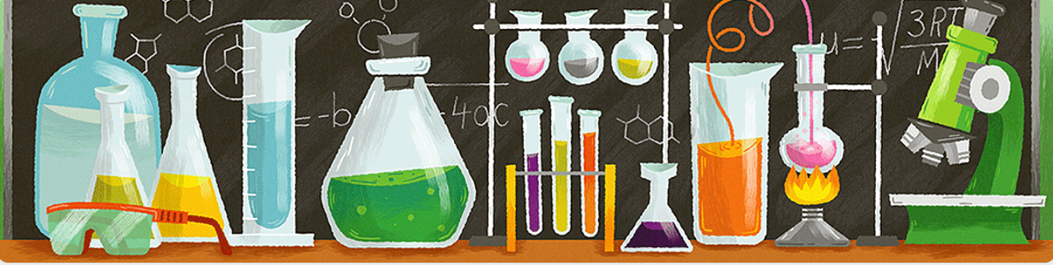
Mentor/Mentee Logs
Your name
Your mentor’s/mentee’s name
Date of meeting
Duration of meeting
Type of meeting
Quality of your mentoring relationship
Well-being of your mentee
Matters that require immediate intervention
Suggestions to improve the mentoring experience

Slide 7
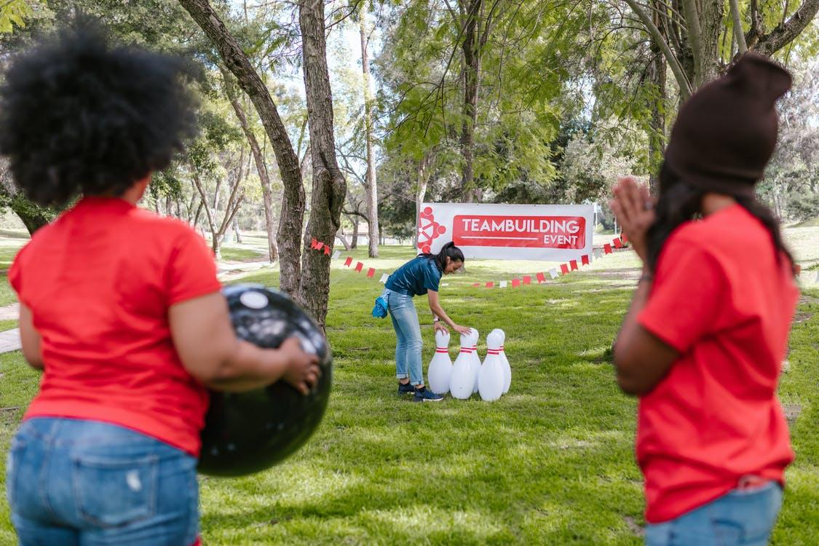
More Details
Money will be provided to student members to join professional organizations like ACS or SACNAS (a short form will be required)
Mentor and mentee logs must be submitted after each meeting

Slide 8
*Tentative* Schedule for the Program
Date* | Event
Friday, October 15th | How to be a Good Mentor/Mentee
November 10th or 12th | Conversations Matter with Dr. Alfreda James
TBD (mid January) | Get-together amongst student members
Friday, February 11th | Team Building Activity with the Rec Center
Friday, February 25th 2-3 PM | Career Design with Dr. Alfreda James
Friday, March 11th 2-3 PM | Interviewing with Dr. Alfreda James
Friday, April 9th 2-3 PM | Negotiations with Dr. Alfreda James
Friday, May 13th | Closing Ceremony
TBD (late May) | Post-program survey
TBD (early June) | Post-program survey is due
Notes:
Mention which workshops we’ve chosen based on their responses
10AM – 3PM -> 10th
11AM – 3PM -> 12th

Slide 9

Peer/Professional Mentor/Mentee Training

Slide 10
Mentoring critical factor in
  Enhancing the academic and professional development of students
  Engaging and retaining students in STEM graduate programs
  Increasing the participation of groups traditionally underrepresented in academia
  Promoting and advancing of employees in academia, government, and industry

Slide 11

Roots of mentoring
  Historically, mentoring has been one-to-one relationship where an experienced mentor serves to guide and morally support a less experienced mentee
    New models of mentoring allow for different types of mentoring relationships
      Online relationships
      Professional organizations/mentoring
      Peer mentoring

Slide 12

Why peer mentoring?
  In general, people take their peers’ perspectives very seriously.
  Due to the similarity in age of peer mentors to their mentees, mentees might also feel more comfortable sharing concerns and problems with their mentors.
Why professional mentoring?
  People learn from more experienced mentors about the skills that they need to develop for success in their careers.
  It expands their network.
This Photo by Unknown Author is licensed under CC BY-SA-NC
Notes:
Why Peer Mentoring?
In general, people take their peers’ perspectives very seriously. This means that a positive peer mentoring relationship can have profound effects on a mentee’s sense of self-worth.
Due to the similarity in age of peer mentors to their mentees, mentees might also feel more comfortable sharing concerns and problems with their mentors. This increases mentee access to appropriate support and resources during times of struggle.

Slide 13
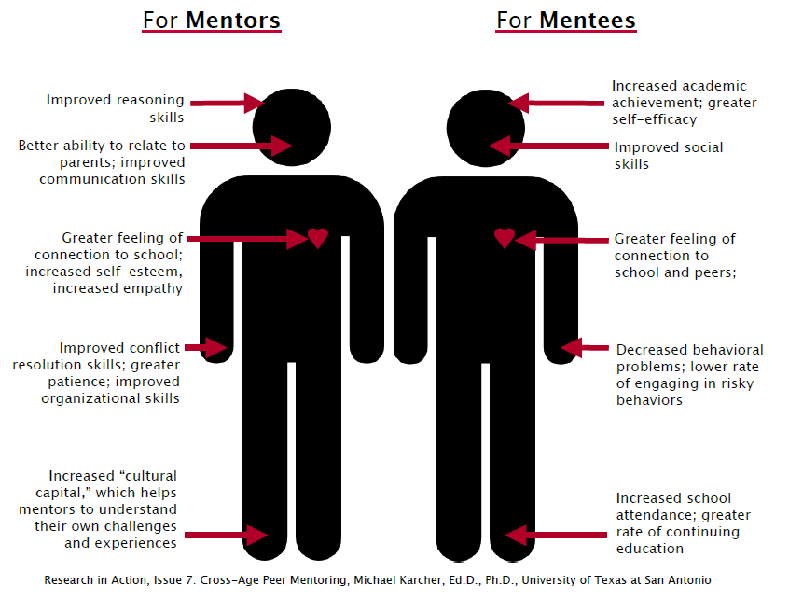
Benefits of mentoring

Slide 14
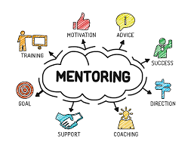
What a Mentor Is . . .
  A knowledgeable and experienced guide
  A caring, thoughtful, and humane facilitator
  A role model
  A trusted ally, or advocate
Notes:
A knowledgeable and experienced guide who teaches (and learns) through
a commitment to the mutual growth of both mentee and mentor.
• A caring, thoughtful, and humane facilitator who provides access to
people, places, experiences, and resources outside the mentee’s routine
environment.
• A role model who exemplifies in word and deed what it means to be an
ethical, responsible, and compassionate human being.
• A trusted ally, or advocate, who works with (not for) the mentee and on
behalf of the mentee’s best interests and goals

Slide 15

What a Mentor Is Not. . .
  A (surrogate) parent
  A professional counselor or therapist
  A flawless or infallible idol
  A social worker
  A lending institution
  A playmate or romantic partner

Slide 16
As a Mentor, Do Expect…
  The relationship to be one directional, at least to start
  Some change to happen
  To support your mentee in reaching their goals
  To experience some frustration as a mentor
  To be busy
  To make some impact in your mentee’s life
Notes:
While it’s great to have goals that you and your mentee can work towards, it’s
important to remember that the purpose of mentoring is to build a relationship. Your
primary mission should be to establish trust and to be a supportive role model in your
mentee’s life.
It’s also important to keep in mind that the goals you work toward should come from
your mentee. If you have goals for your time together, try to focus them on yourself
within your role – to improve your listening skills, to become solution-oriented, or to
be the best mentor you can be.

Slide 17
As a Mentor, Do NOT Expect…
  To “reform” or “save” your mentee
  Your mentee to confide in you or trust you, at least to start
  Great change quickly
  Your goals to mirror your mentee’s goals for themselves
  That you will be “best-friends-at-first-sight”
  Your mentee to schedule meetings or to develop plans

Slide 18




Your Role as a Mentor
Model Behavior
Create Learning Experiences
Focus on the Positive
Encourage
Notes:
Model Behavior: What you do is as important as what you say. Use your behavior to promote learning and positive development in your mentee.
Create Learning Experiences: Keep an eye out for teachable moments. Take advantage of local resources to cultivate their existing interests.
Focus on the Positive: Approach challenges from a place of optimism and possibility.
Encourage: Help your mentee build self-esteem and self-confidence.

Slide 19
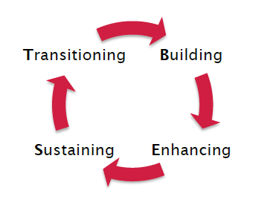
The B.E.S.T. model demonstrates the typical lifecycle of mentor relationships: building, enhancing, sustaining, and transitioning.
Notes:
All relationships go through stages. The B.E.S.T. model demonstrates the typical lifecycle of mentor relationships: building, enhancing, sustaining, and transitioning. These stages are not always clear-cut and frequently overlap. Sometimes, relationships return back to an earlier stage and cycle through more than once. Read on to learn more about each stage individually – what it is, what you can expect, and some tools and tips for making the most of the relationship in each stage.
Building: The first stage of the mentoring lifecycle is building the relationship – meeting your mentee for the first time, establishing trust, clarifying roles, and agreeing on boundaries are all part of this stage.
Enhancing: Stage two involves enhancing the mentoring relationship. This means exploring interests in depth, setting goals, and offering yourself as a resource to your mentee.
Sustaining: In the third stage of the mentoring relationship, trust has been established and conversation is more comfortable, personal, and open. Working on goals might be a central focus of the relationship.
Transitioning: Change can be a scary thing, but they can be made easier by preparing for them. A good way to prepare for relationship transition with your mentee is to talk about it! Celebrate how much you have accomplished, and remind your mentee how much time remains. Part of these discussions should include what you want your relationship to look like once the program ends.

Slide 20

Before your first meeting….
  Think about the information you want to share with your mentee/mentor
    Your experience at SBU
    Your experience prior to SBU
    Your degree program and how it may relate to your mentee’s program
    What you wish you would have known as a 1st year graduate student

Slide 21
      Initial Meeting
        Share information about yourself
    Preferred name or nickname
    Academic background
      Schools previously attended, length of time at SBU, what attracted you to come here
    Any information regarding interests and hobbies that you feel comfortable sharing
    Why you decided to become a mentor/mentee
    Your availability
    Contact information

Slide 22
      Initial Meeting
  Get information about your mentee/mentor
    Preferred name or nickname
    Degree program & classes they are taking
    Academic background
      Schools previously attended, length of time at SBU, what attracted them to come here
    Previous experience with mentoring
    Any information regarding interests and hobbies that they feel comfortable sharing
    Their availability
    Contact information

Slide 23
Future meetings
  Establish regular times to meet
    Most successful mentoring relationships are ones that have consistency
    Be punctual!!!
  Touch upon issues/topics discussed at previous meetings
    Take notes, if necessary

Slide 24

After each meeting
  Complete log/updates as soon as possible!

Slide 25
Establishing Trust and Boundaries

Slide 26

Establishing Trust and Boundaries
  Stress confidentiality
    Ensure that mentee understands that any information shared with you will remain confidential, except in special circumstances
      Mentor/Mentee logs: Any information shared with BSD will remain confidential, except in special circumstances
    Do not share mentee information with colleagues, friends, or family

Slide 27
Establishing Trust and Boundaries
  Confidentiality: Special circumstances
    If mentee reports that they are thinking about harming themselves or others, you must contact Norma Reyes and the appropriate authorities immediately (police, paramedics, etc.)
    Can refer students to Counseling and Psychological Services (CAPS)
      Counseling and Psychological Services (CAPS)
        (631) 632-6720
        http://studentaffairs.stonybrook.edu/caps/index.shtml

Slide 28
Establishing Trust and Boundaries
  Confidentiality: Special circumstances
    If mentee reports being the victim of discrimination or harassment, contact Norma Reyes
    Can refer students to Office of Diversity and Affirmative Action (ODAA)
        (631) 632-6280
        http://www.stonybrook.edu/diversity/
  Once situation is reported, it then becomes confidential information to the person to whom it is reported to
    You may not receive follow-up information
    Continue to be a sympathetic mentor to your mentee, but do not ask for further disclosure on that topic

Slide 29
Establishing Trust and Boundaries
  Important to establish boundaries
    Maintain a professional and respectful attitude toward each other
    If at any time, your relationship with your mentee extends to beyond what you are comfortable with, contact Norma Reyes immediately
      Know your limits
        Ask for help and referrals before you get overwhelmed with your mentee’s problems
      Do not try to solve your mentee’s problems by yourself
        Your mentee is an adult and is responsible for their own life

Slide 30
Establishing Trust and Boundaries
  Important to establish boundaries
    Romantic relationships are inappropriate
      Need to maintain a professional distance
    Do not communicate by touch
      Can be misinterpreted and can make your mentee uncomfortable
    Do not make inappropriate remarks, gestures, jokes, touches, or teasing
      What may be funny to you can be sexually intimidating, hostile or offensive to your mentee

Slide 31
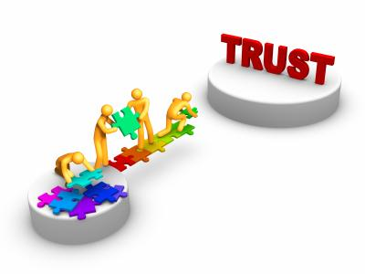
9 Tips for Establishing Trust
  Be a Friend
  Listen
  Mutual Respect
  Take a Step Back
  Be Consistent
  Be Supportive
  Have Fun!
  Be Yourself
  Be Realistic
This Photo by Unknown Author is licensed under CC BY-NC-ND
Notes:
Be a Friend: Be your mentee’s peer and friend – not another authority figure or parent.
Listen: Try to pick up on your mentee’s interests, concerns, and goals through active listening. Don’t give advice unless asked first.
Mutual Respect: Don’t impose your beliefs or push your mentee to do things they don’t want to do. Know that you are two different individuals.
Take a Step Back: Make sure your mentee knows that they are the focus. Let them decide what to do, what to talk about, and what goals to work on.
Be Consistent: Do what you say you’ll do. Follow through. Be present and attentive to your mentee while you’re together.
Be Supportive: Avoid dismissive language like “that’s not a big deal.” Show that you’re on their side no matter what. Have their back.
Have Fun! Resist the urge to be totally focused on goals. Having fun together in the beginning can help you work on more challenging things later on!
Be Yourself: Don’t put on a role to try and “connect” with your mentee. Being authentic is the best thing to do!
Be Realistic: Don’t agree to extravagant requests – things that cost unreasonable amounts of time, money, or effort. Be realistic when setting goals.

Slide 32
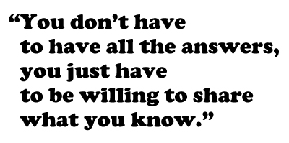


Slide 33

Contact us!
Please email bsd_chem@stonybrook.edu if you have any questions, concerns, comments, etc.

