Slide 1
ENHANCING RESEARCH PRODUCTIVITY & EFFECTIVENESS PROPOSAL – April 23, 2021

Slide 2
Enhancing Research Productivity
Co-Chairs:
Sandeep Mallipattu, Associate Professor, Medicine; Chief, Division of Nephrology and Hypertension
Surita Bhatia, Professor, Department of Chemistry
Initiative Type: Key Enabler
Problem Statement: Lack of strategic hiring, barriers to collaboration, under-staffed RF admin, and loss of productive faculty
Opportunity: Focus on large grants and training grants

Slide 3
Current State
SBU faculty teaching burden high (per FTE):
10.5 (School of Marine and Atmospheric Sciences)
27.3 (College of Arts and Science)
32.8 (College of Engineering and Applied Sciences)
AAU rankings: faculty FTE low and declining

Slide 4
What We Learned
Seed grants are crucial to build interaction needed for successful large-scale grants
Diversifying faculty is important for success
Data from OVPR Seed Grant program (since 2018):
Extramural funding success rate for seed-funded proposals : 22%
RF invested $2.3M, resulted in $13M in seed-funded awards
Gain = $10.7M, ROI = 470%
$200k investment suggests $1M return (5×)
SBU ranks below peers in training grants
Insufficient OPD staff for grant submissions
Little to no data collection on faculty retention. (last survey was 2017 COACHE)

Slide 5
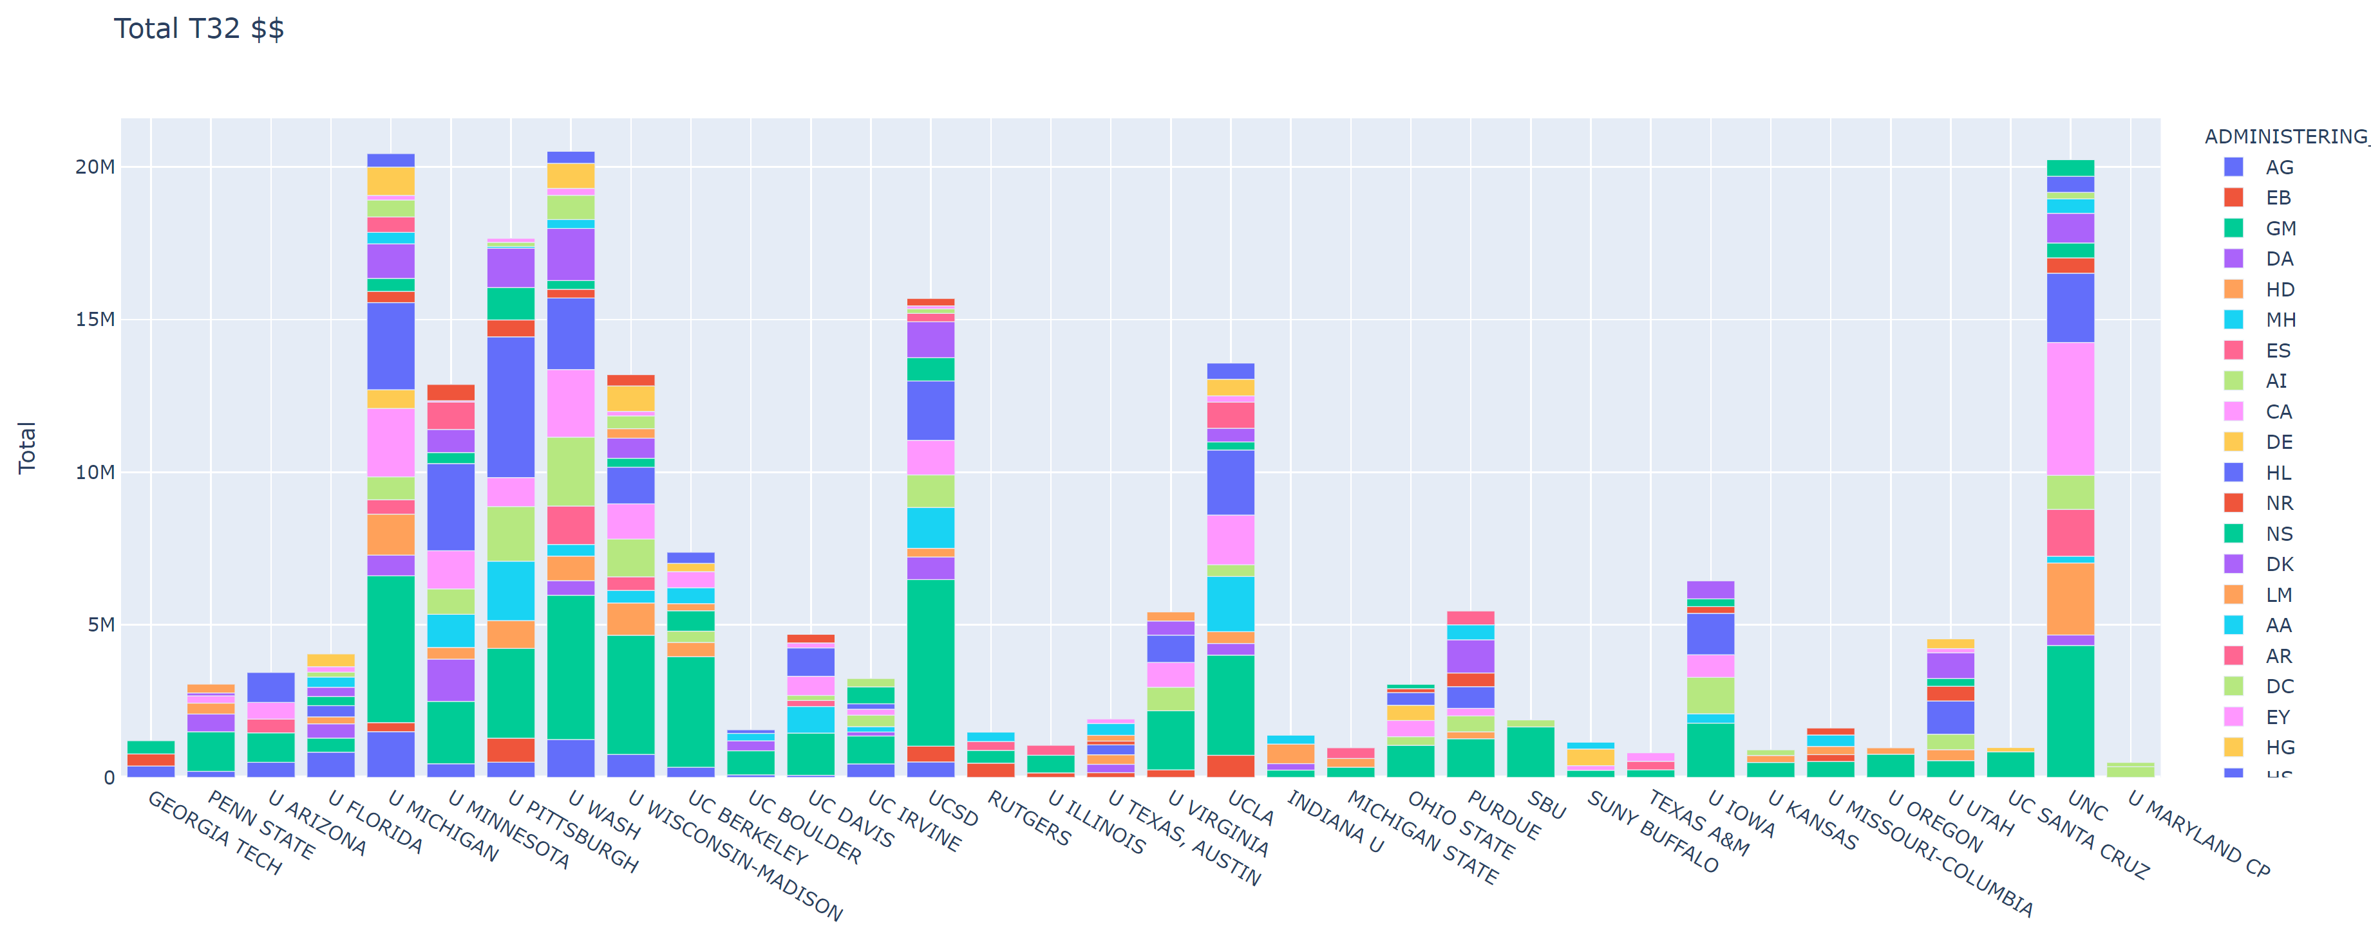
What We Learned (cont.): T32 Awards and NIH at SBU
Funding institute at NIH
SBU
Nearly all T32s from NIGMS
1 from NIAID
Top 6 institutes for all SBU NIH T32 awards:
NIGMS
NCI
NIAID
NIMH
NIA
NINDS
SBU below peers in all disease-specific T32s
Opportunities for training grants where critical mass exists (NCI, NIMH, NIA, NINDS; additional awards from NIAID)
Source: NIH RePORTER

Slide 6
Recommendations
Expand seed grant programs:
2 × $70k for very large grants
3 × $25k additional SBU/BNL seed grants
$20k for on-campus team-building workshops
Bridge funding ($ TBD)
Administrative support for training and center grants
Exit interviews to improve retention
Balance and redistribute faculty research/teaching obligations
Develop new models for strategic hiring to renew faculty and retain current faculty in areas of strength

Slide 7
Recommendations: Goals
Increase training grants submissions by 25% over 5 years
2 additional submissions per year, leading to total awards $3M -- $10M
Increase number of center grants submissions by 25% over 5 years
1-2 additional per year, leading to increase in total awards of $5M -- $20M
Increase cross-institutional, multi-PI grants submissions by 25% over 5 years
Move from bottom to third quartile among public AAU in 5 years by increasing total research expenditures from $125M → $155 million ($6M or ~5% increase annually)

Slide 8
Costs/Benefits Analysis
Benefits:
Expand collaborations within SBU and with BNL
Enhance research success and associated benefits for IDC and AAU standing
Strategic hiring
promotes cohesion of clusters and builds on strengths
anticipates or responds to new opportunities
improves AAU ranking via additional highly productive FTE
High reputational and strategic impact
Costs:
Investment in Seed Grants <$500k annually, less than 1 FTE
Ongoing investment for research support: 4 FTE
Strategic hiring one-time investment: $500k ~ 1 M per faculty (high-profile hires) and ongoing investment TBD to scale with desire for growth

Slide 9
Thank you! Questions and feedback?

